Slide 1
B.Tech Project Semester Presentation
Praneeth A S Anuroop Kakkirala

Slide 2
What we did??
Recognize humans present in the images using HOG descriptors
Used Linear SVM(SVM light) to train and classify images
Succeeded in classifying the positive and negative images from the test images given in the dataset with considerable accuracy

Slide 3
Data Set for Training
INRIA Dataset
614 human images as positive in train
1218 images as negative which do not contain human in train
228 human images in test which are positive
453 images without human in test which are negative
Humans with different poses and backgrounds

Slide 4
What is HOG??
Histogram of Oriented Gradients (HOG) are feature descriptors used in computer vision and image processing for the purpose of object detection.
The technique counts occurrences of gradient orientation in localized portions of an image.
The HOG descriptor maintains a few key advantages over other descriptor methods. Since the HOG descriptor operates on localized cells, the method upholds invariance to geometric and photometric transformations, except for object orientation.
The HOG descriptor is thus particularly suited for human detection in images.

Slide 5
HOG Algorithm
Input: Set of Images of size 128 × 64
Output: HOG Descriptors for each image
1. Divide the Image window of size 128 × 64 into 8 × 8 blocks // Total 15 × 7
blocks
2. Calculate Gradient Histograms for every block
3. Collect 22 cells and normalize the histograms obtained above.
4 × 9 histograms per cell // Normalization
4. Concatenate Histograms // Total vector size =15 × 7 × 2 × 2 × 9 = 3780

Slide 6
Our Implementation Gradient computation
To ensure normalized colour and gamma values.
Used 3 types of Gradient Variations:
1) [ -1, 0,1] – Centered
2) [-1,1] – Uncentered
3) [1,-8,0,8,-1] - Cubic centered

Slide 7
Orientation binning
Change in number of Orientation bins: 9, 8
The orientation bins are evenly spaced over 0° to 180°
("unsigned” gradient)

Slide 8
Block normalization
Let v be the non-normalized vectors containing all the histograms in the block.
We used two kinds of normalizations
L2 Norm :
L1 Norm :

Slide 9
SVM classifier
The final step in object recognition using Histogram of Oriented Gradient descriptors is to feed the descriptors to SVM.
For training the images we labelled the positive images as +1 and negative images as -1.
Once the training is done we tested it with the test images.
Used Linear SVM
Used SVM light software package

Slide 10
Colour Images with L1 Norm
Gradient | No.of Bins | Accuracy
[-1,0,1] | 9 | 86.22
[-1,1] | 9 | 84.86
[1,-8,0,8,-1] | 9 | 87.07
[-1,0,1] | 8 | 86.22
[-1,1] | 8 | 84.86
[1,-8,0,8,-1] | 8 | 86.05

Slide 11
Colour Images with L2 Norm
Gradient | No.of Bins | Accuracy
[-1,0,1] | 9 | 88.1
[-1,1] | 9 | 85.88
[1,-8,0,8,-1] | 9 | 86.73
[-1,0,1] | 8 | 86.05
[-1,1] | 8 | 85.37
[1,-8,0,8,-1] | 8 | 86.56

Slide 12
Grayscale Images with L1 Norm
Gradient | No.of Bins | Accuracy
[-1,0,1] | 9 | 86.91
[-1,1] | 9 | 87.85
[1,-8,0,8,-1] | 9 | 87.45
[-1,0,1] | 8 | 86.77
[-1,1] | 8 | 87.18
[1,-8,0,8,-1] | 8 | 86.77

Slide 13
Grayscale Images with L2 Norm
Gradient | No.of Bins | Accuracy
[-1,0,1] | 9 | 86.91
[-1,1] | 9 | 87.85
[1,-8,0,8,-1] | 9 | 87.85
[-1,0,1] | 8 | 86.77
[-1,1] | 8 | 87.18
[1,-8,0,8,-1] | 8 | 86.77

Slide 14
Observations…
After converting colour image to grayscale we observe that normalizing histograms with L1-Norm or L2-Norm has no effect
Best results were obtained in the following conditions:
[-1, 0, 1] L2-Norm 9 bins

Slide 15
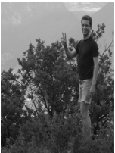
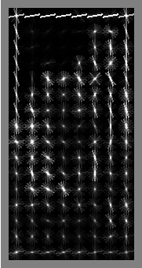
HOG Visualization 9 bins

Slide 16
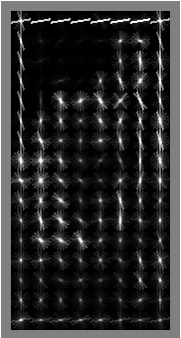
HOG Visualization 8 bins

Slide 17
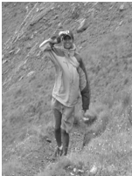
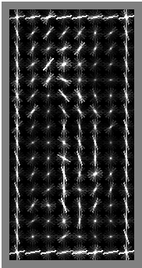
HOG Visualization 9 bins

Slide 18
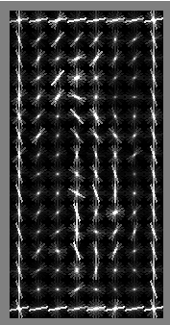
HOG Visualization 8 bins

Slide 19
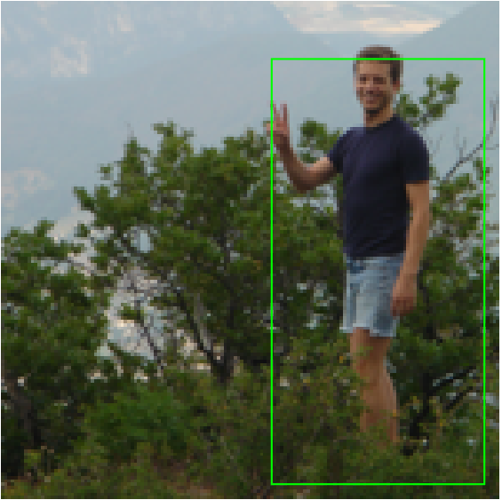
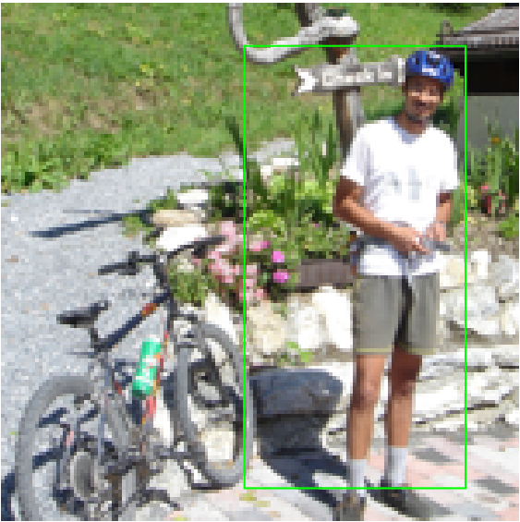
Sample Recognition of Humans in Colour Images(Green Box around human)

Slide 20
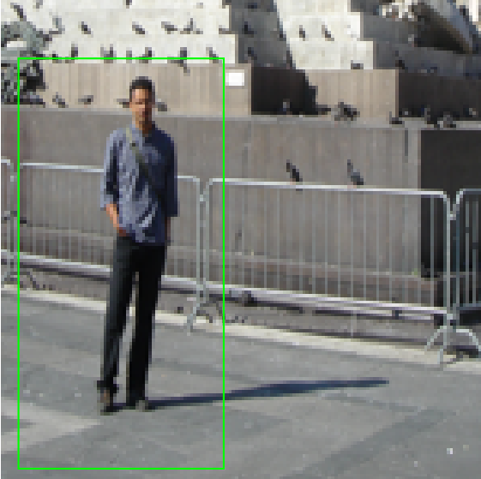
Sample Recognition of Humans in Colour Images(Green Box around human)

Slide 21
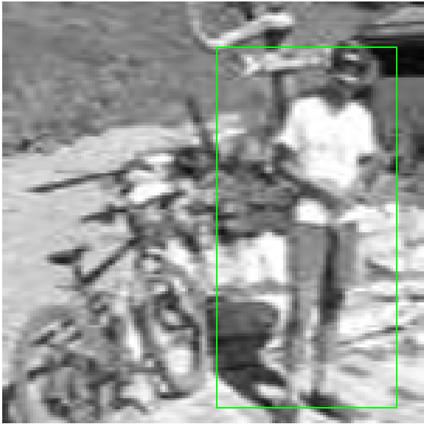
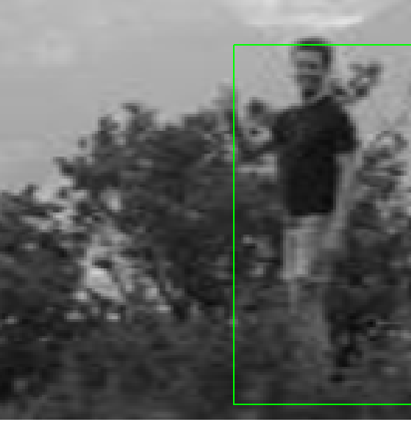
Sample Recognition of Humans in Grayscale Images(Green Box around human)

Slide 22
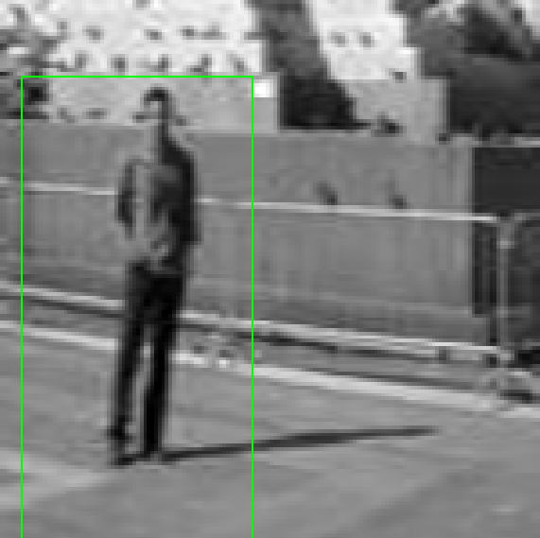
Sample Recognition of Humans in Grayscale Images(Green Box around human)

Slide 23
Thank You!!!

